Slide 1
ANKIT SHARMA PRESENTS
Secure Your Angular App
Using
JWT And GraphQL

Slide 2



Ankit
SDE III at Cisco Systems, India
Author & Speaker
GDE for Angular, Microsoft MVP
Blog https://ankitsharmablogs.com/
in/ankitsharma-007
@ankitsharma_007

Slide 3
What this talk is about?
JWT
GraphQL
.NET based GraphQL server with secure APIs using JWT.
Angular client to consume the API using Apollo Angular.
Route guards to secure routes.
in/ankitsharma-007
@ankitsharma_007

Slide 4
Technology stack
.NET
Angular
GraphQL
Hot Chocolate for server
Apollo Angular for client
in/ankitsharma-007
@ankitsharma_007

Slide 5
What is JWT?
JWT - JSON Web Token
A compact and self-contained way for securely transmitting information between parties as a JSON object.
The information shared can be verified and trusted because it is digitally signed.
JWTs can be signed using a secret (with HMAC algorithm) or a public/private key pair using RSA.
in/ankitsharma-007
@ankitsharma_007

Slide 6
What is JWT?
Compact: Because of its size, it can be sent through an URL, POST parameter, or inside an HTTP header. Additionally, due to its size its transmission is fast.
Self-contained: The payload contains all the required information about the user, to avoid querying the database more than once.
in/ankitsharma-007
@ankitsharma_007

Slide 7
When should we use JWT?
Authorization : Once the user is logged in, each subsequent request will include the JWT, allowing the user to access routes, services, and resources that are permitted with that token.
Information Exchange : A great way of securely transmit information between parties. Since the JWTs can be signed, you can be sure the senders are who they say they are.
in/ankitsharma-007
@ankitsharma_007

Slide 8
Structure of JWT
XXXXX.YYYYY.ZZZZZ
Header
Payload
Signature
in/ankitsharma-007
@ankitsharma_007

Slide 9
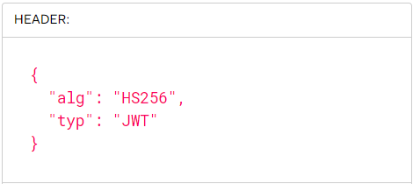
JWT Header
Two parts:
Type of token
Signing algorithm
in/ankitsharma-007
@ankitsharma_007

Slide 10
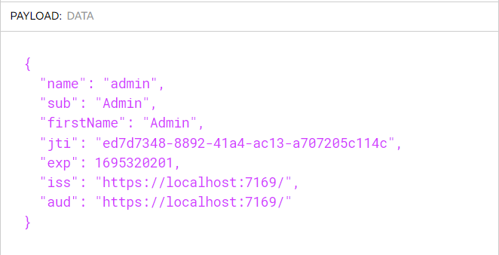
JWT Payload
Contains the claims.
Claims are statements about an entity (typically, the user) and additional data.
in/ankitsharma-007
@ankitsharma_007

Slide 11
JWT Signature
The signature is used to verify that the message was not changed during transmission.
If the token is signed with a private key, it can also verify that the sender of the JWT is who it says it is.
in/ankitsharma-007
@ankitsharma_007

Slide 12
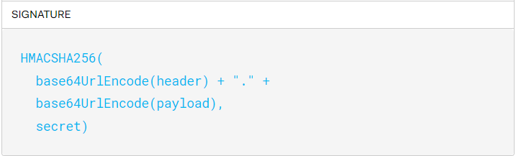
JWT Signature
To create the signature, we should sign the encoded header and the encoded payload using the specified algorithm with the help of a secret key.
in/ankitsharma-007
@ankitsharma_007

Slide 13
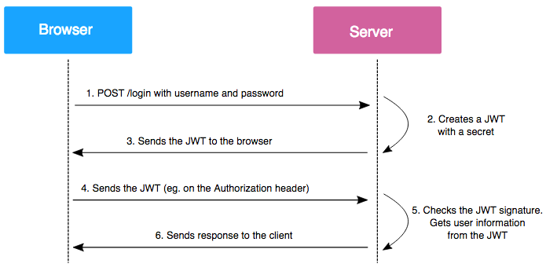
How does JWT work?
in/ankitsharma-007
@ankitsharma_007

Slide 14
What is GraphQL?
GraphQL is a query language for APIs.
Allows the client to ask for the specific data that it needs.
Apps that use GraphQL are fast and stable because they control the data they get, not the server.
Open source.
in/ankitsharma-007
@ankitsharma_007

Slide 15
Hot Chocolate
Hot Chocolate is an open-source GraphQL server for the .NET platform.
Allows us to create GraphQL endpoints.
Easy to set up and allows us to deliver our application quickly by removing the need to build a fully-fledged GraphQL server.
in/ankitsharma-007
@ankitsharma_007

Slide 16
Apollo Angular
Apollo Angular is the ultra-flexible, community driven GraphQL client for Angular, JavaScript, and native platforms
Features:
Incrementally adoptable
Universally compatible
Simple to get started with
Small and flexible
Community driven
in/ankitsharma-007
@ankitsharma_007

Slide 17
GraphQL Query
A GraphQL query is used to fetch values from a server.
It is a read-only operation.
It is similar to a GET operation in REST.
in/ankitsharma-007
@ankitsharma_007

Slide 18
GraphQL Mutation
A GraphQL mutation is used to change the data on the server.
It is similar to a POST/PUT/DELETE operation in REST.
in/ankitsharma-007
@ankitsharma_007

Slide 19
Prerequisites
Visual Studio 2022 with the ASP.NET and web development workload
Angular CLI
Node.js
VS Code (optional)
in/ankitsharma-007
@ankitsharma_007

Slide 20
Demo Time !!!
in/ankitsharma-007
@ankitsharma_007

Slide 21
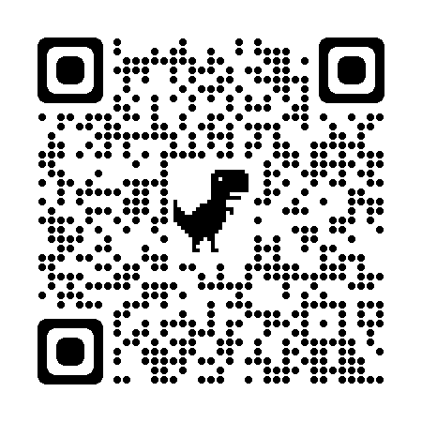
Resources
Scan QR for GitHub repo
https://jwt.io
https://graphql.org/
https://chillicream.com/
in/ankitsharma-007
@ankitsharma_007

